Slide 1
Routing of 50-node Network via Link-State Algorithm – An Application of Dijkstra’s Algorithm
EE-357 Communication & Computer Networks – End Semester Project

Slide 2
Team
Muhammad Sohaib Ikram (283756)
Abdul Ahad Sheikh (282457)
Hammad Hassan (309328)
Danyal Wali (300230)

Slide 3
Agenda
Problem Statement
Introduction
Objectives
Modules
Challenges Faced
Prospects
Conclusion

Slide 4

Problem Statement
Consider 50 nodes at random positions. Get them connected in such a way that each node must have 4 interfaces and all the 4 interfaces are connected to 4 other nodes. Only the source and destination nodes have 3 interfaces. The source is at least 30 nodes away from destination. Assign each link a random value from 1 to 15. Calculate total number of paths from source to destination. Among those paths, select the shortest path. Also, calculate the number of hops for each path. Highlight total number of iterations used to find the shortest path. Repeat the experiment for 10 times with different random values and check the shortest path.

Slide 5
Introduction
A routing algorithm is a procedure that lays down the route or path to transfer data packets from source to the destination.
Types
Link-State
Distance Vector

Slide 6
Objectives
Learn and Implement Routing Protocol Algorithm
1
Find the shortest distance from source to destination
2
Find the least number of hopes required (in the shortest distance) from source to destination
3
Find all paths from source to destination
4

Slide 7
Modules
Network Topology
1
Calculating Shortest Path
2
Calculating Number of Hops
3
Calculating Total Number of Paths

Slide 8
Network Topology
Source and Destination has 3 nodes
All other interfaces with 4 nodes
Randomize cost value
Cost Matrix
Adjacency Matrix

Slide 9
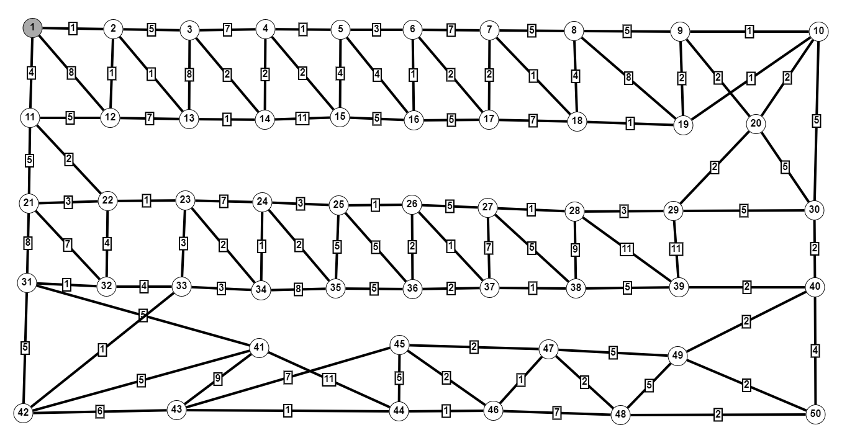
Network Topology
https://graphonline.ru/en/#

Slide 10
Adjacency/Cost matrix
An adjacency matrix is a way of representing a graph as a matrix of booleans (0's and 1's). A finite graph can be represented in the form of a square matrix on a computer, where the boolean value of the matrix indicates if there is a direct path between two vertices
In case of multigraph representation, instead of entry 0 or 1, the entry will be between number of edges between two vertices. In case of weighted graph, the entries are weights of the edges between the vertices. The adjacency matrix for a weighted graph is called as cost adjacency matrix.

Slide 11
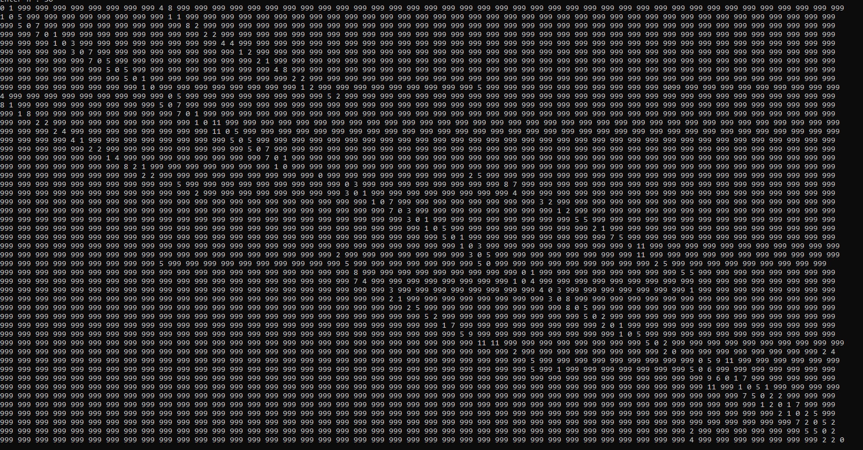
Cost matrix for our topology

Slide 12
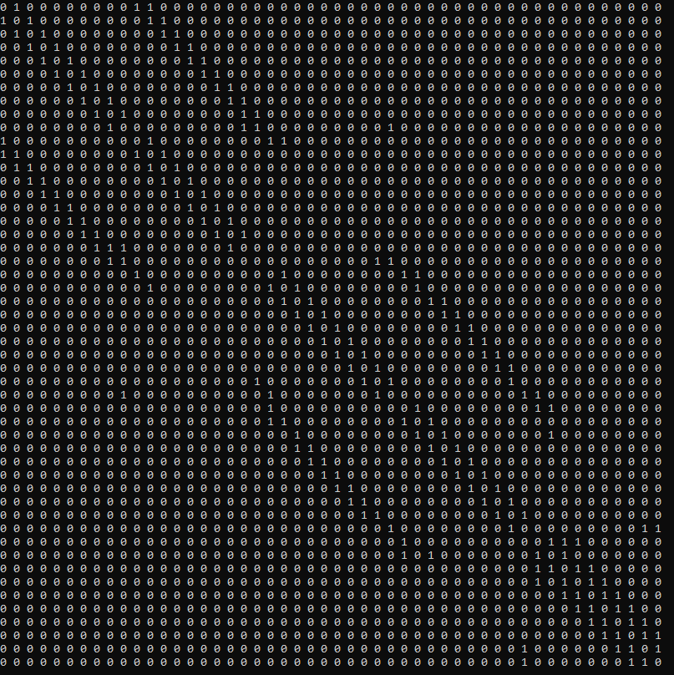
Adjacency matrix for our topology

Slide 13
Calculating Shortest Path
Dijkstra’s Algorithm
Limitation of this Algorithm
Results (from Tool and Code)

Slide 14
Dijkstra’s Algorithm
Dijkstra's algorithm allows us to find the shortest path between any two vertices of a graph.
Limitation: Does not calculate total number of paths

Slide 15
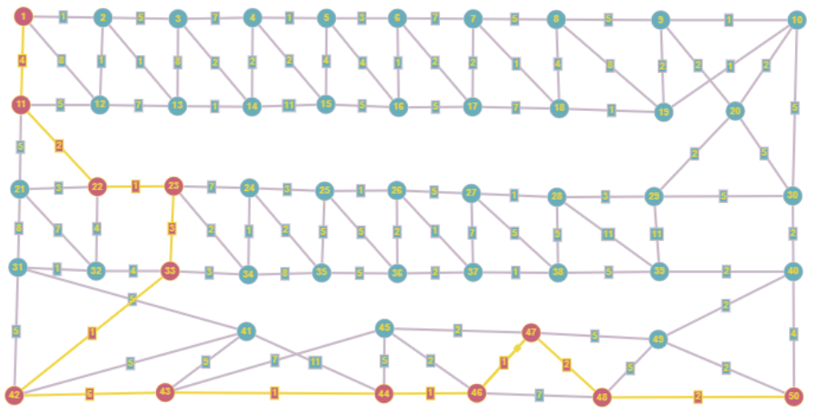
Results for shortest path by tool
http://graphonline.ru/en/?graph=QoSYJcKAMlXPJemA

Slide 16
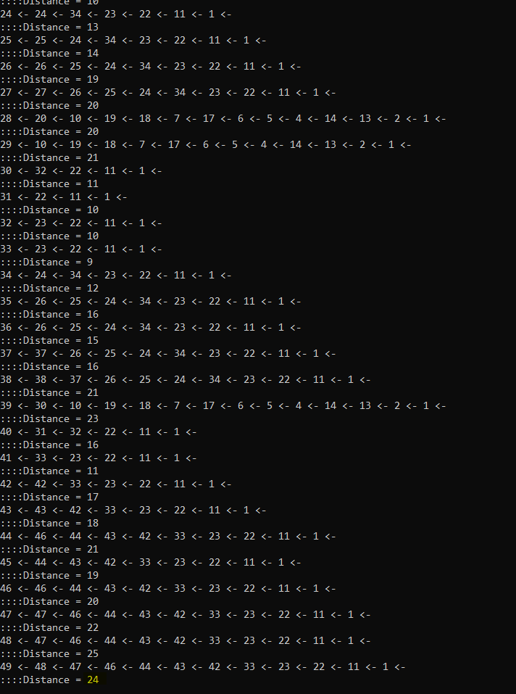
Results for shortest path by code
https://github.com/SohaibIkram/Dijkstra-s-algorithm-to-find-shortest-path-from-source-to-destination/blob/main/Source.cpp

Slide 17
Calculating Number of Hops
Results by Tool
Results by Code

Slide 18
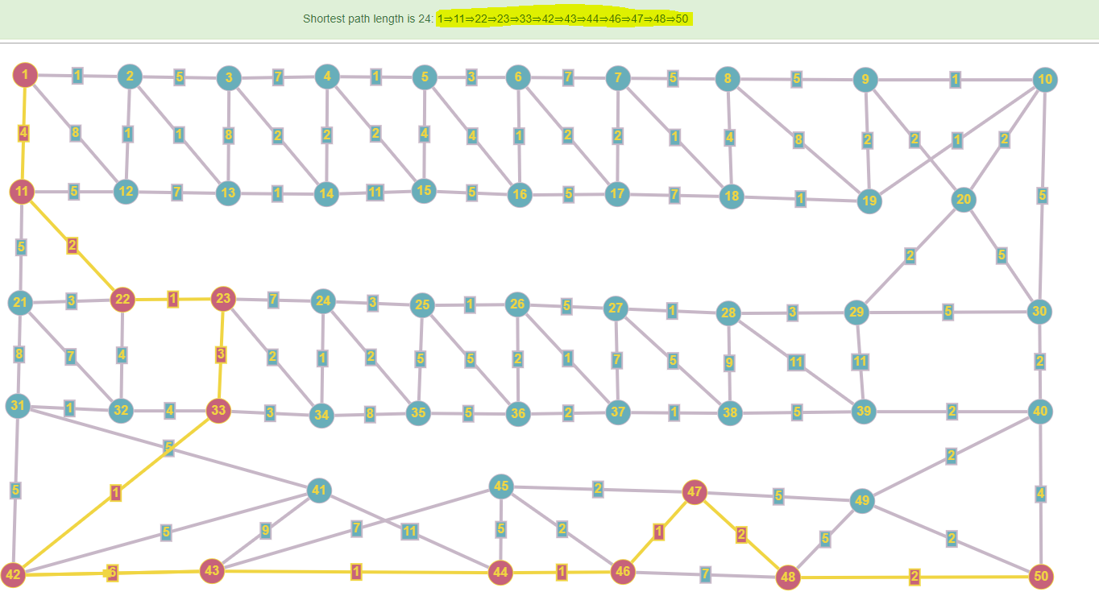
Results for number of hops by tool
http://graphonline.ru/en/?graph=QoSYJcKAMlXPJemA

Slide 19
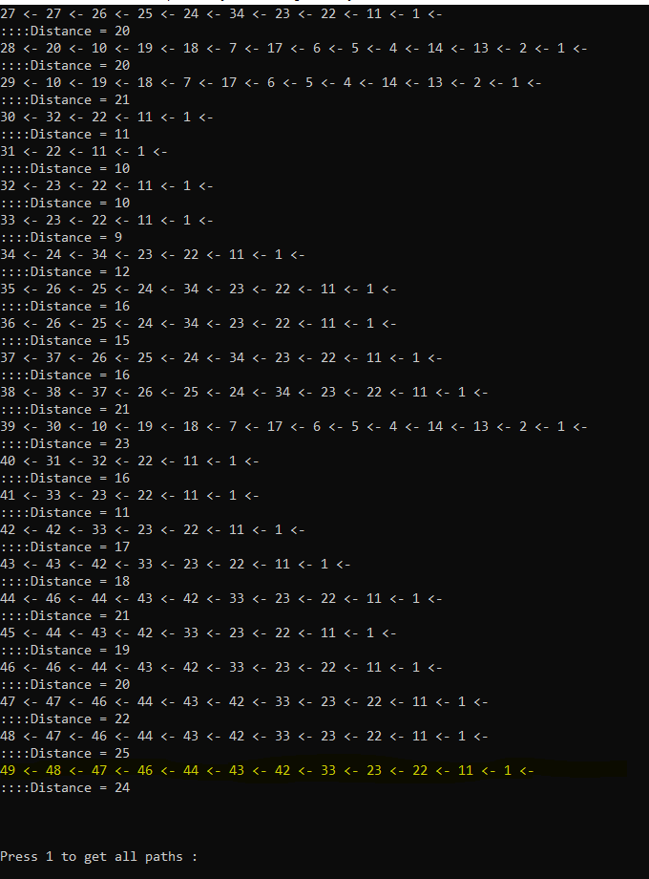
Results for shortest path by code
https://github.com/SohaibIkram/Dijkstra-s-algorithm-to-find-shortest-path-from-source-to-destination/blob/main/Source.cpp

Slide 20
Calculating Total Number of Paths
Concept of Directional/Non-Directional Graphs
Concept of Cyclic/Acyclic Graphs
Conclusion

Slide 21
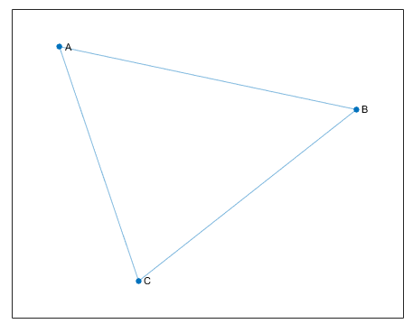
Undirectional Graphs
Undirected graphs have edges that do not have a direction. The edges indicate a two-way relationship, in that each edge can be traversed in both directions. This figure shows a simple undirected graph with three nodes and three edges.

Slide 22
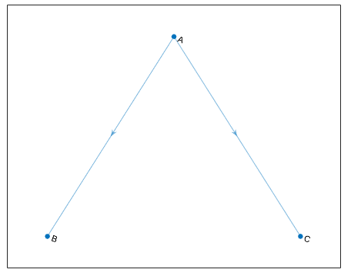
Directional Graphs
Directional graphs have edges with direction. The edges indicate a one-way relationship, in that each edge can only be traversed in a single direction. This figure shows a simple directed graph with three nodes and two edges.

Slide 23
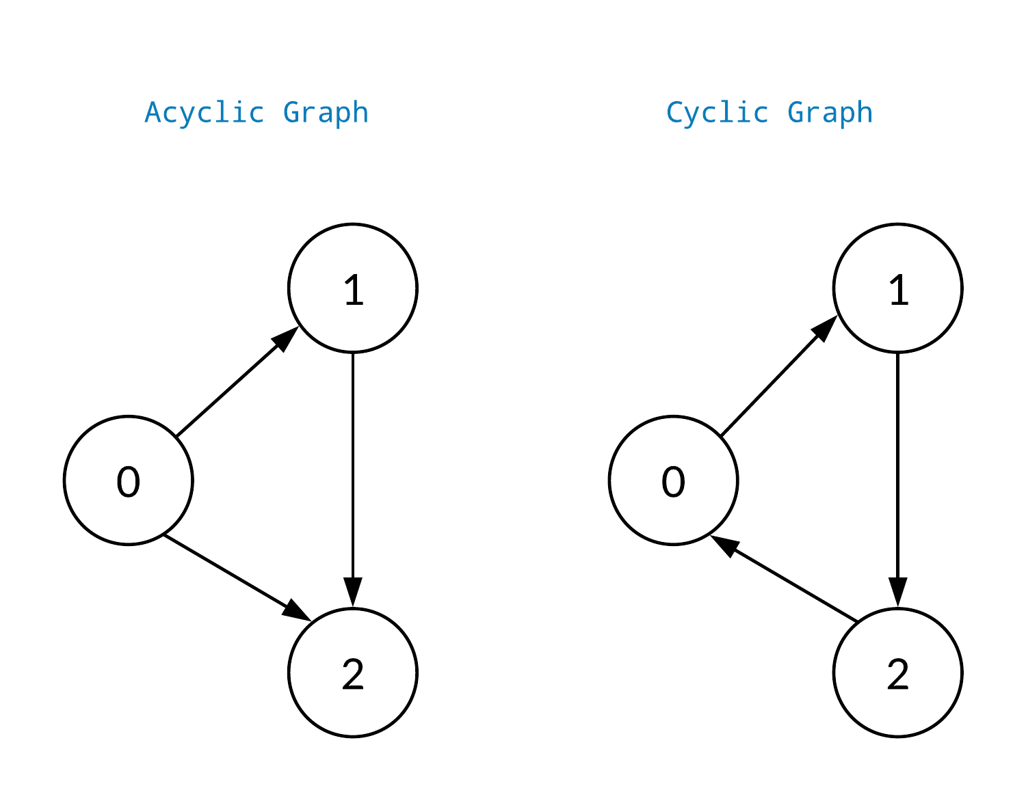
Cyclic/Acycil Graphs
A cyclic graph is a graph containing at least one graph cycle.
A graph that is not cyclic is said to be acyclic.

Slide 24
Conclusion of total number of paths
A cyclic graph i.e., it is not a DAG (Directional Acyclic Graph), the number of paths between two nodes can be infinite

Slide 25
Challenges Faced
50 Nodes Complexity
Cyclic Graph

Slide 26
Best way to escape from your problems is to solve them
Robert Anthony

Slide 27
Prospects
Decreasing Time and Space Complexity of our Program
Implementation of Image Processing based IIOT device that takes in Topology Diagram to give desired outputs
Feature increasing in terms of incorporating directional graphs
ML based predictions for efficient routing

Slide 28
Conclusion/Summary
A Dijkstra algorithm based shortest route and its number of hops calculator program is being implemented in C++ that takes in cost matrix for network topology and gives accurate answers

Slide 29
References
https://stackoverflow.com/questions/9535819/find-all-paths-between-two-graph-nodes
https://github.com/SohaibIkram/Dijkstra-s-algorithm-to-find-shortest-path-from-source-to-destination/blob/main/Source.cpp
https://www.mathworks.com/help/matlab/math/directed-and-undirected-graphs.html#:~:text=Undirected%20graphs%20have%20edges%20that,graphs%20have%20edges%20with%20direction.
https://graphonline.ru/en/?graph=QoSYJcKAMlXPJemA
https://www.simplilearn.com/tutorials/cpp-tutorial/random-number-generator-in-cpp#:~:text=How%20to%20Generate%20Random%20Numbers%20in%20C%2B%2B%20Within%20a%20Range,(rand()%20%25%20100).

Slide 30

Thank you

